Slide 1
MyPerformance
Year End Review Process 2020

Slide 2
Background
Current State
MyPerformance framework and system was launched to APT and Management groups in 2016
SAFA joined the online system this year (2019-2020)
AUPE continues to complete their performance reviews using paper forms (word document)
Collective agreements require annual performance reviews
Future Opportunities to Change
We hear you - the current framework is not adding value for leaders or employees, it’s cumbersome and complex, and fails to meet the fundamental goal of helping employees make progress in their work, feel engaged, and develop.

Slide 3
The Plan
Current circumstances present an opportunity to move towards a simplified performance process as we reexamine the best way forward to encourage employee progress, productivity and engagement.
interim, quick year end performance review
leadership engagement on future of performance
propose new process
pilot, review, adjust
launch to full organization
We are here
Coming soon

Slide 4
Interim Year End Performance Review
Simplified self and leader ratings on 3 areas (role, goals, competencies)
3 quick clicks, and you are done ! (but comments available too)
Not rating each individual goal (no need to have goals in the system)
Will not have an “overall” performance rating
Removing the calibration step
Leaders can move the process along at their own pace (this could realistically be completed in a day)
A conversation with employees about their performance is the most fundamental part of this process. This is priority above all else.

Slide 5
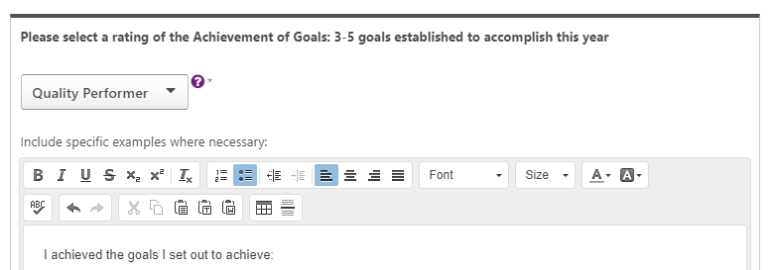
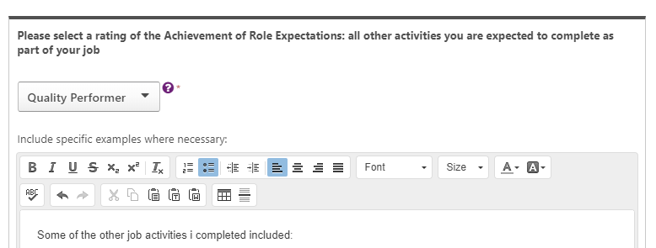
Quick Demo
Ratings:
Outstanding year
Above and beyond
Quality performer
Partially achieved expectations
Did not meet expectations
New to role

Slide 6
Steps to complete year end
Launch May 11 Due May 25 | Employee reviews goals and completes self rating Achievement of goals Achievement of role expectations Demonstration of competencies
Due June 8 | Leader completes ratings of employee performance
 | Leader and employee have year end conversation
 | Leader submits rating
Due June 15 | Employee and leader sign off
The above dates are guidelines. Employees on vacation can complete the review when they return. The system will remain open until at least September.

Slide 7
Rating Scale Flowchart
Start
Quality Performance
Yes, and…
No…
Work activities, goals, and/or competencies were achieved as expected.
Above and Beyond
Partially Achieved Expectations
Work activities, goals, and/or competencies were surpassed through better results achieved, larger scope, and/or better timing than initially agreed upon.
Achieved only some aspects of the work, goals, and competencies. For example, missed important tasks and timelines, failed to achieve agreed upon objectives, and/or did not behave in a collaborative,
Yes, and…
Outstanding Year
Yes, and…
Work activities, goals, and competencies were surpassed and made a greater than expected contribution to the business. The work successfully impacted overall SAIT strategic priorities in a demonstrable way.
Did Not Meet Expectations
Did not achieve agreed upon work, goals, and competencies.

